Slide 1
Secure Data Hiding in Image Using Steganography SECURE DATA HIDING IN IMAGE USING STEGANOGRAPHY
CAPSTONE PROJECT
Presented By:
Student Name : Potnuri Pujitha Priyanka
College Name & Department : International School Of Technology And Sciences For Women (CSE-AI)

Slide 2
OUTLINE
Problem Statement
Technology used
Wow factor
End users
Result
Conclusion
Git-hub Link
Future scope

Slide 3
Problem Statement
With the rise of digital communication, ensuring secure data transmission has become a crucial challenge. Traditional encryption techniques can raise suspicion, making them vulnerable to attacks. Steganography provides a method to hide sensitive information within images, making data transfer more secure and discreet. This project focuses on implementing a secure image-based steganographic system that enables efficient data hiding without compromising image quality

Slide 4
Technology used
Programming Language: Python
Libraries:OpenCV2,Hardware(OS),String
Platform: VS Code or Python IDLE

Slide 5
Wow factors
Uses LSB-based image steganography for secure data hiding.
Minimal distortion to the original image, maintaining high visual quality.
Can encode and decode hidden messages with password protection.
Real-world applications in confidential communication and watermarking.
Supports Jpg Format.

Slide 6
End users
Government and Defense Organizations
Journalists and Whistleblowers
Corporate Businesses for Secure Data Transfer
General Users for Private Communication
Army Defences for securing and Hiding Data.

Slide 7


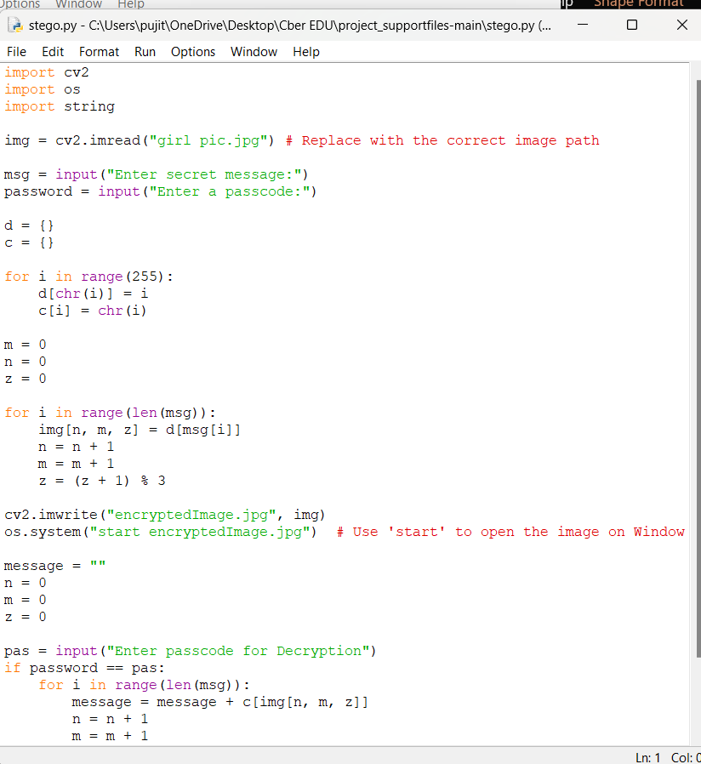
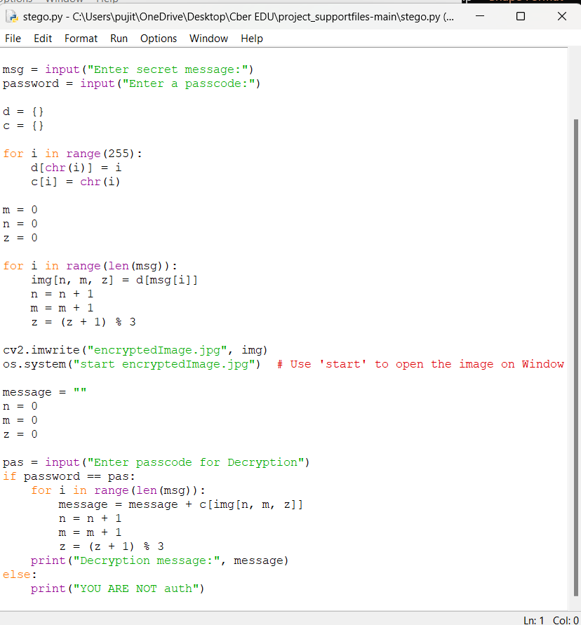
Results
Output:
Input:
Code for Encrypt:
Code for Decrypt:

Slide 8
Conclusion
This project successfully demonstrates how steganography can be used as a secure means of hiding sensitive data within images.
The system ensures minimal data loss and high confidentiality, making it a valuable tool for secure communications.

Slide 9
GitHub Link
Make sure that there should be readme file
https://github.com/Priya-smiley/Stegno.git

Slide 10
Future scope(optional)
Implementing AI-based techniques to enhance security.
Developing a mobile application for easy accessibility.
Integration with blockchain for added security and verification.
Exploring audio and video steganography techniques.

Slide 11
THANK YOU

